Slide 1
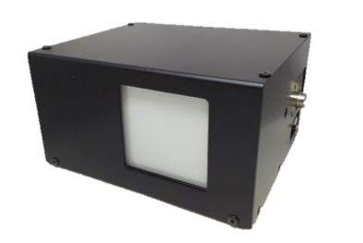
Kokyo
Beam profiler for large diameter and high power
LaseView-LHB
・Maximum diameter : 50 mm x 50 mm
・Maximum input power : 100 W/cm2
・Including software and camera
・Beam diameter measurement, analysis functions
and auto-range adjustment are available
Image/LaseView-LHB
Composition
This is a beam profiler for large diameter and high power. Beam profile is addressable only by introducing laser into LaseView-LHB. Laser with low power (1 mW/cm2~) is also available. LaserView is included as software and various
analysis functions make LaseView-LHB useful.
Software
Power adapter
Laser beam receiving
(including CCD camera)
Price and lead time
Price：USD 14,800 (Ex-works Japan)
（without Tax）
Lead time： Around 1 - 1.5 months
after order receipt
Application
・ Laser processing and laser microscope
• OCT
• Development for laser light source
• THz wave generation
• Evaluation for material property
• Education and training on laser
Operational conditions
・Windows Vista SP1
・Windows 7
・Windows 8、Windows 8.1
・Windows 10
Operation is not always guaranteed on PC
with above Windows OS.
For further product information,
http://en.symphotony.com/pick-upproductsbeam-
profiler-for-large-diameter-andhigh-power/

Slide 2
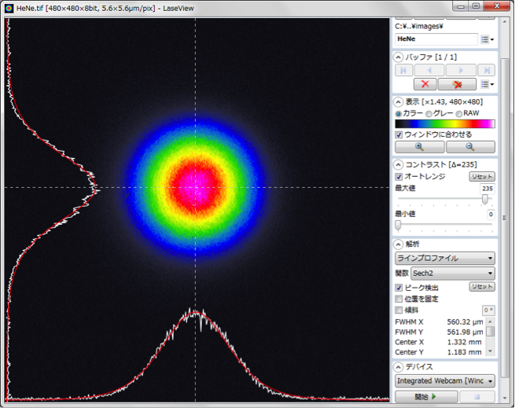
Kokyo
Analysis functions
• Line profile
• Integration profile
• Maximum intensity projection
• Point - point distance
• Peak integration
 | Specification
Measurement for acceptance surface | 50 × 50 mm
Optics resolution | 100 μm
Measurement power density | 0.1 〜 100 W/cm2 (detection is adjustable depending on exposure time) (1 mW/cm2 〜 is available by changing ND filter)
Total irradiation power | Maximum 10 W
Measurement wavelength range | 400 〜 1100 nm (Adjustment already made on 532 nm or 932)
* Maximum 100 mm x 100 mm beam diameter is available.
* Infrared wavelength region is measureable by custom.
For further information,
Kokyo
No.5 Hase Bldg. 2F, 637, Suiginyacho, Shimogyo-ku
kyoto-shi, Kyoto, 600-8411, Japan
Email : info@symphotony.com 81-70-6582-2430
Kokyo, Inc.

